Slide 1

YARASA
Ahmet Onur Akman
Enes Çetinberk
Muhammed İbrahim Kılıç
Vuslat Sena Emre
Visual Alert System for Deaf and Hard of Hearing

Slide 2
Project Execution & Results

Slide 3
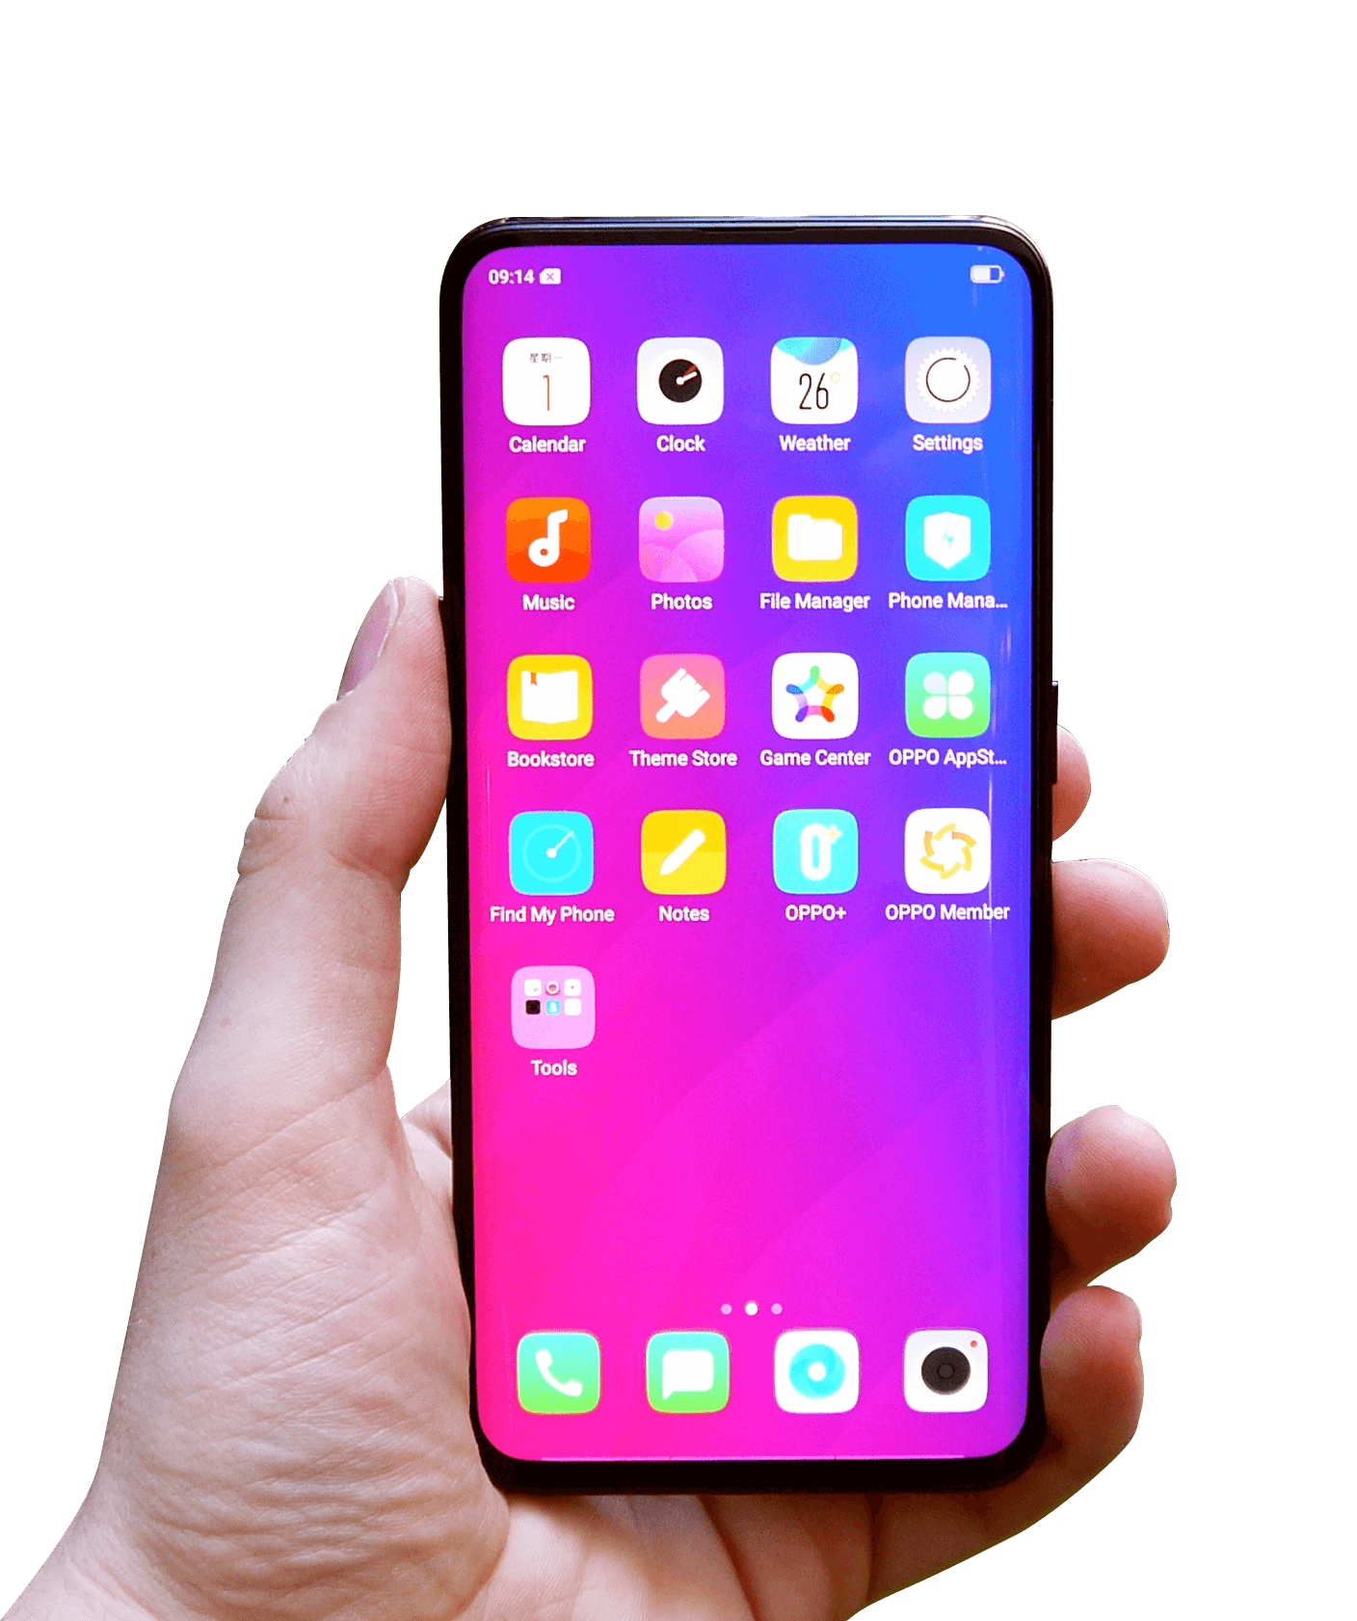
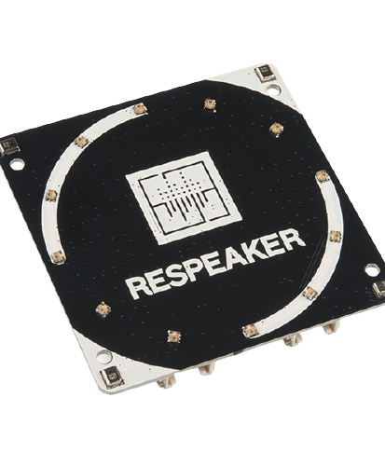
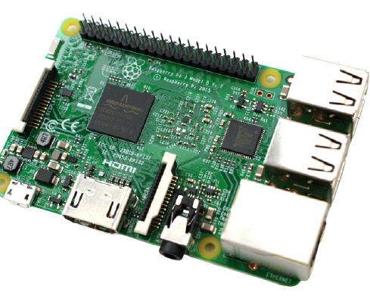
Hardware Requirements
ReSpeaker 4-Mic Array for Raspberry Pi
Raspberry Pi
Android OS Operating Smartphone

Slide 4
Development Process
Gathering Data Set & Preprocessing
Model Training & Testing
Mobile Application Development
Raspberry Pi Environment Prepariation & ReSpeaker Installation
Establishing Bluetooth Communication Between Pi & Android
Testing & Improvements

Slide 5
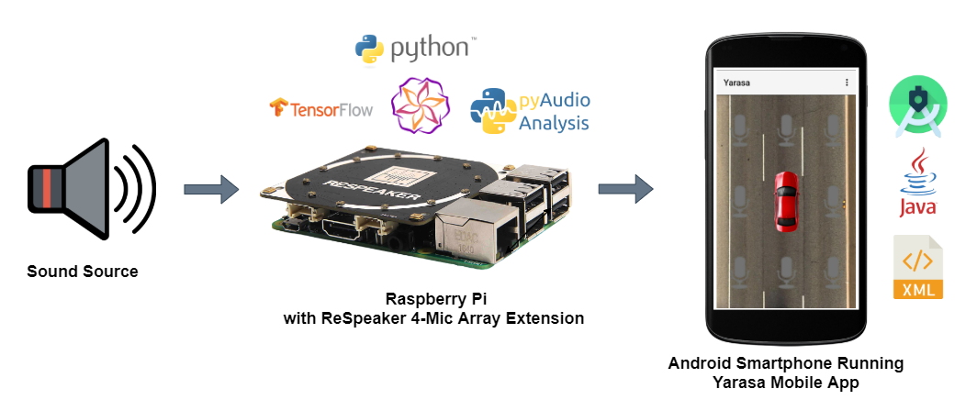
System

Slide 6
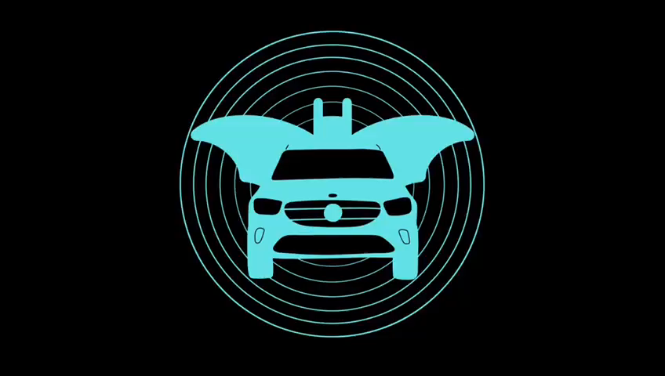
Prototype

